Slide 1



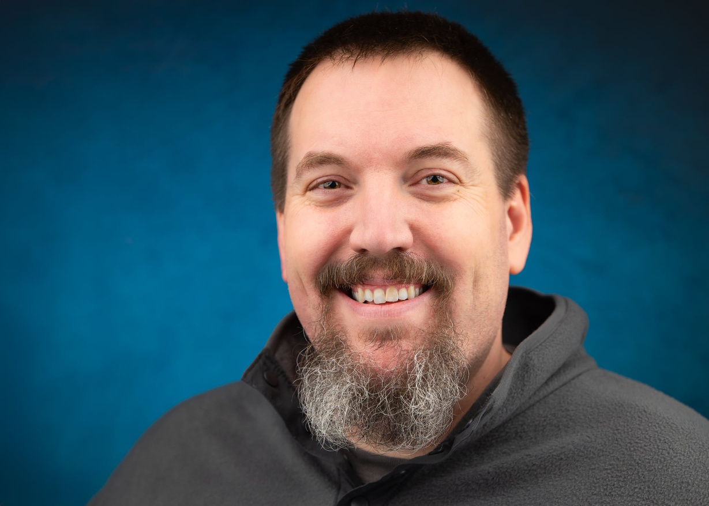

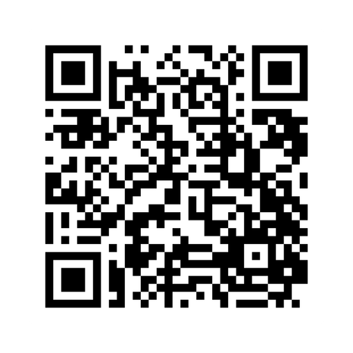
MEN’S
RETREAT
March 27 -28, 2026
More Information
Speaker
Albert Burnham

